Slide 1
Measuring Government Performance Using Sentiments of Tweets: Whether Big Data Match Citizen and Employee Surveys
Roger Qiyuan Jin
POLS 8500
May 2, 2017

Slide 2
Difficulties of measuring government performance
Multiple goals, stakeholders, outcome vs. output, etc
Often rely on perceptual assessment of employees
“Objective” measures are usually proxy measures or indicators
Sentiment of tweets as a measure?

Slide 3
Big Data in Public Affairs
Big data in public affairs, then, is high volume data that frequently combines highly structured administrative data actively collected by public sector organizations with continuously and automatically collected structured and unstructured real-time data that are often passively created by public and private entities through their Internet interactions (Mergel et al.).

Slide 4
Social Media Adoption of US Federal Gov
Social media use has become an accepted practice in the U.S. federal government and around the world.
Following the Open Government Directive agencies are investing resources into working with third party platform providers to harness new technologies to increase citizen participation, collaboration, and transparency (The White House, 2009).
“Harness new technologies”

Slide 5
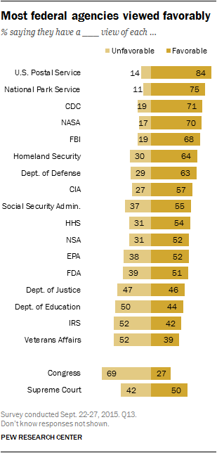
Data
Pew Research Center
17 Agencies
Sep 22-27, 2015
N=1502
Rank

Slide 6
Data
Federal Employee Viewpoint Survey 2015
82 Federal Agencies (use 17)
Administered by OPM
More than 400,000 employees
Aggregate responses about performance
My agency is successful at accomplishing its mission.
How would you rate the overall quality of work done by your work unit?
Rank

Slide 7
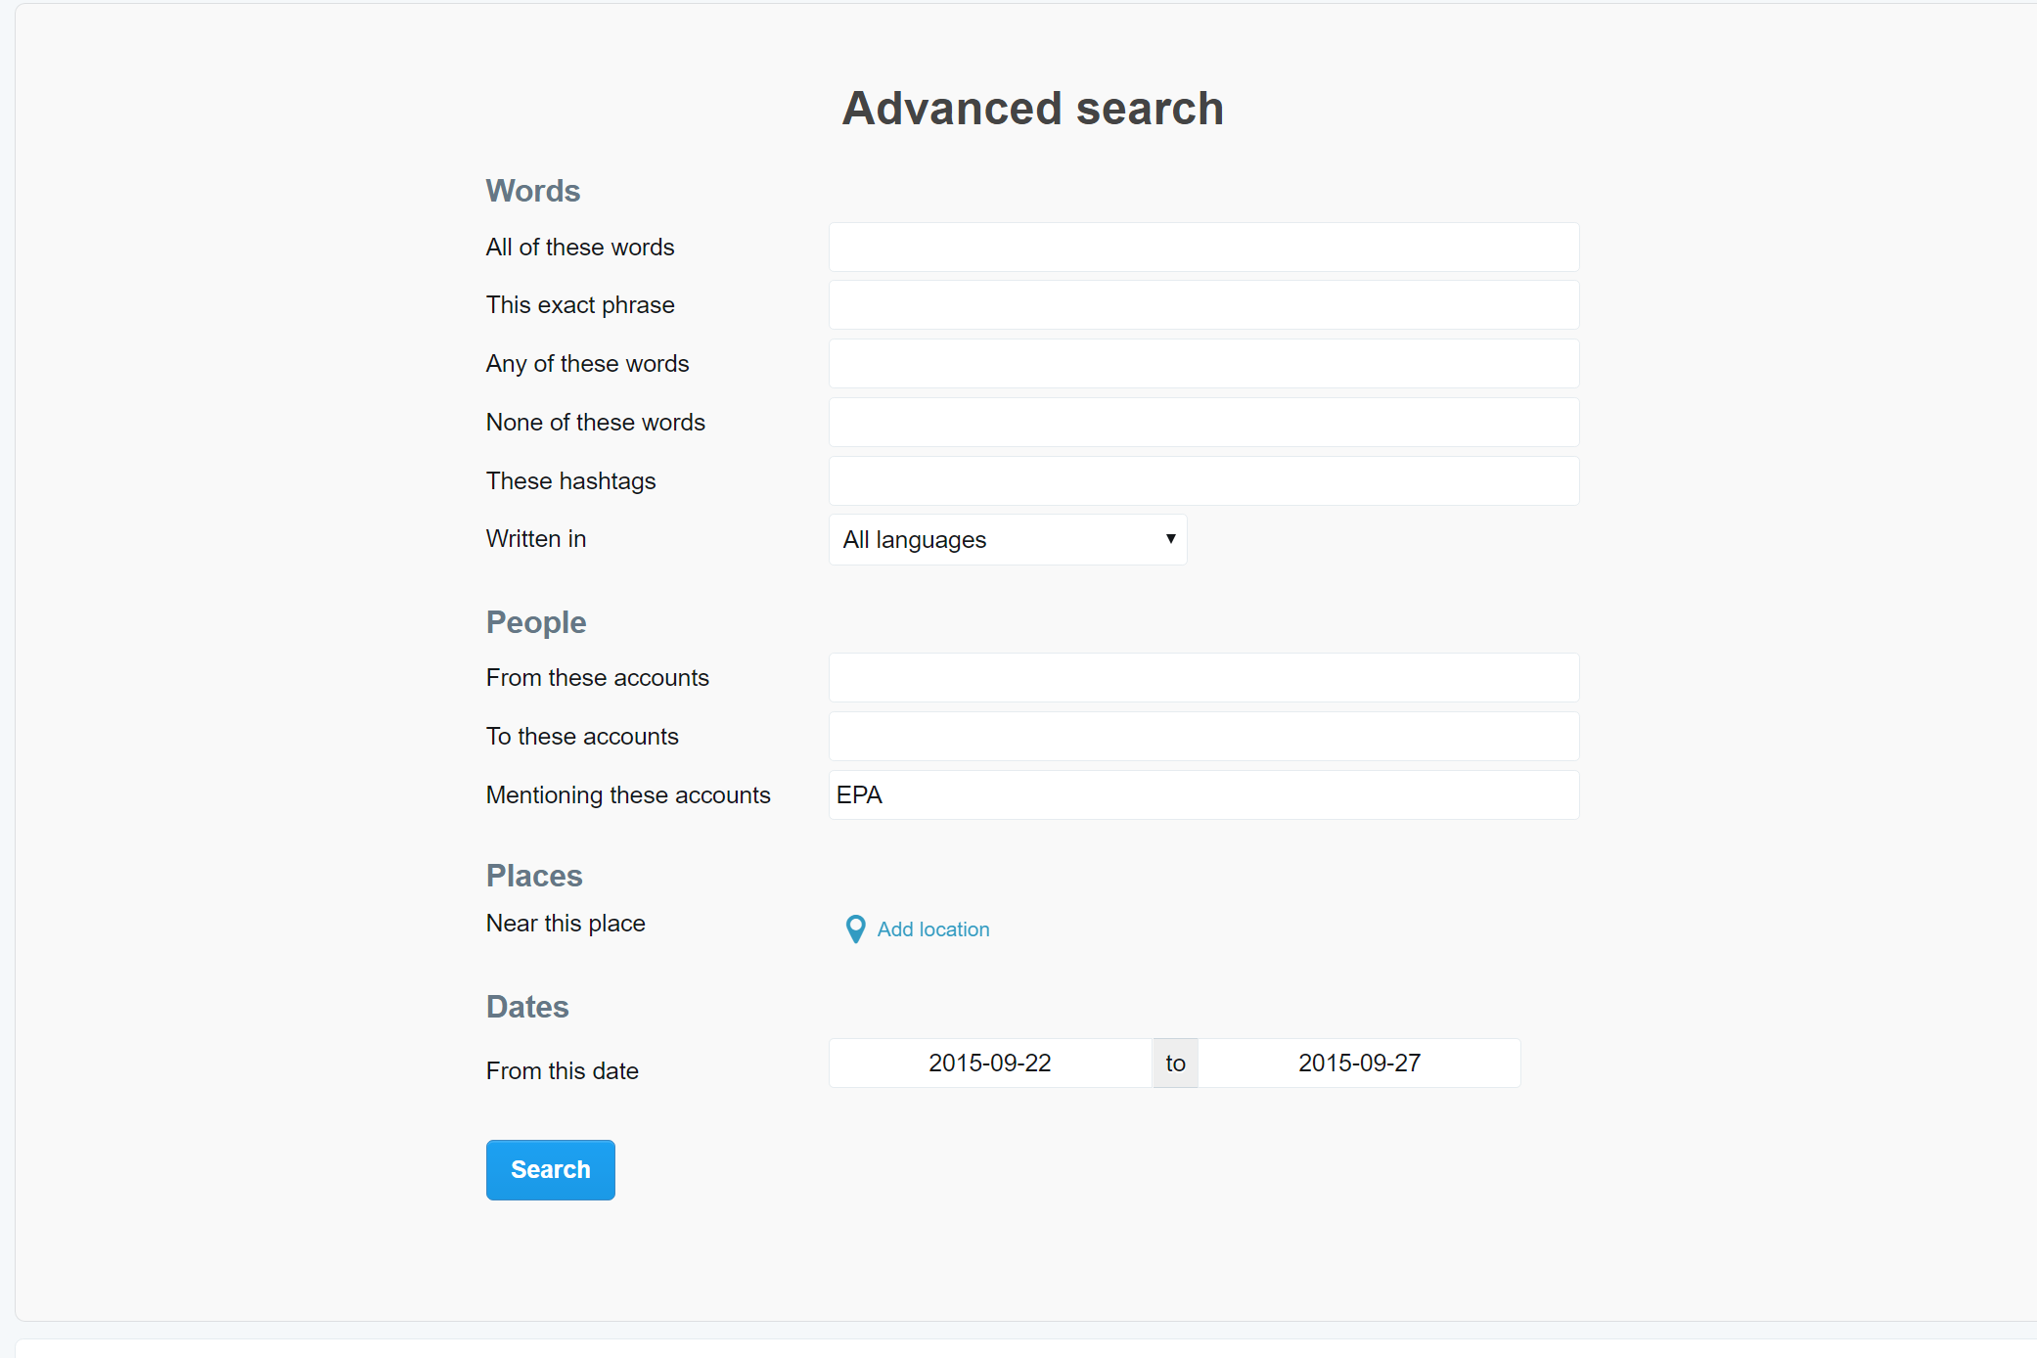
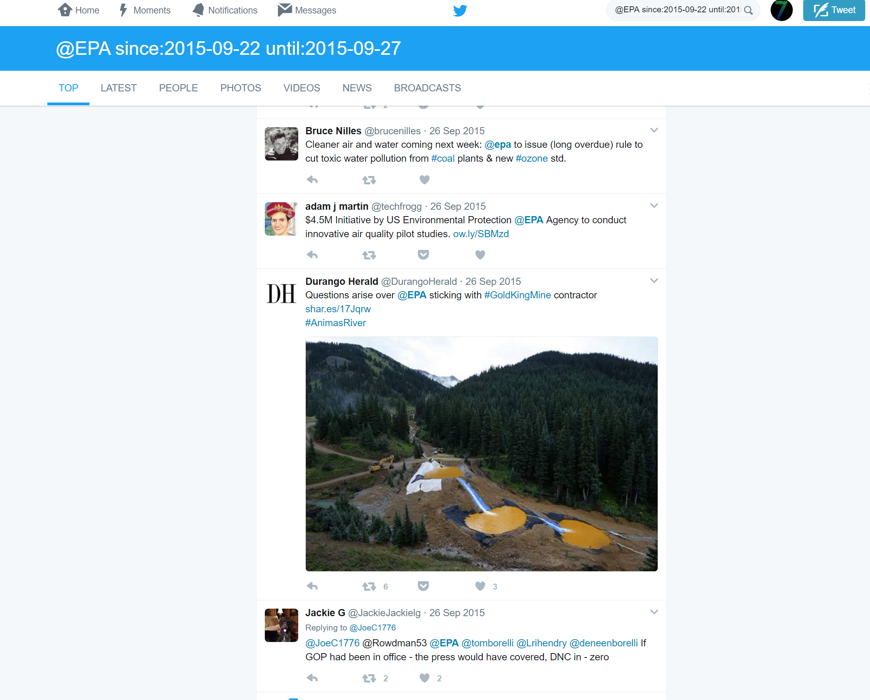

Data
Tweets mentioned 17 federal agencies
EPA, HHS, DHS etc
Sep 22-27, 2015
N=21825
Python Web Scraping Script

Slide 8
Sentiment Analysis
Training data: Sanders-Twitter Sentiment Corpus
5513 hand-classified tweets
positive, negative, neutral and irrelevant
Use only positive and negative
1091 classified tweets, with 572 negative and 519 positive

Slide 9
Sentiment Analysis
SVM Classifier
75% training, 25% test
Confusion matrix
81% accuracy
87% specificity
75% sensitivity
Class and probabilities

Slide 11
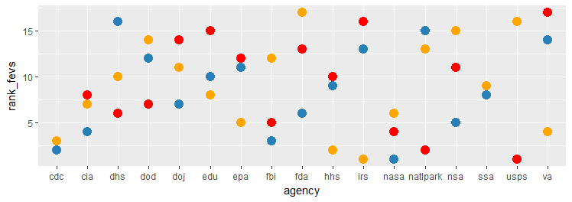
Correlation of Three Ranks

Slide 12
Correlation of Three Ranks
Negative associations
Not significant

Slide 13
Conclusion and Future
Exploratory
Twitter users not representative
Time frame
Performance related data
Reputation vs. Performance
What agencies are tweeting?

